Slide 1


Alpha wrapping with AN offset
Cédric Portaneri, Mael ROUXEL-LABBé, Michael Hemmer, David Cohen-Steiner, pierre Alliez
Notes:
Todo:

Slide 2
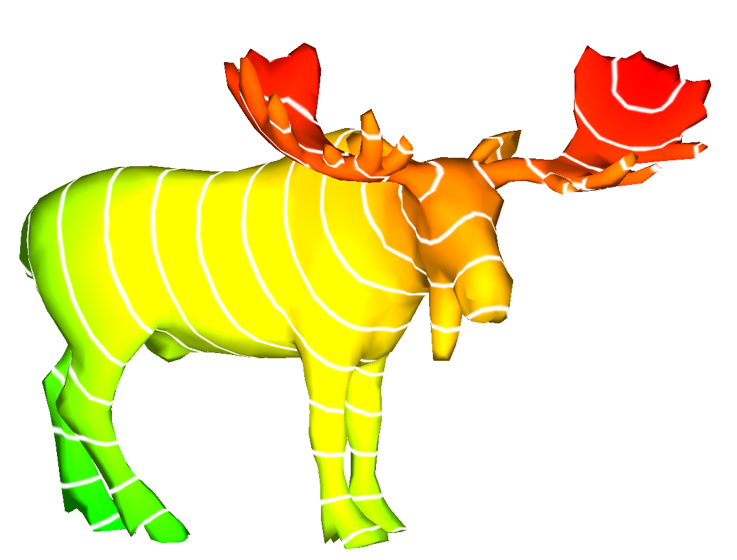
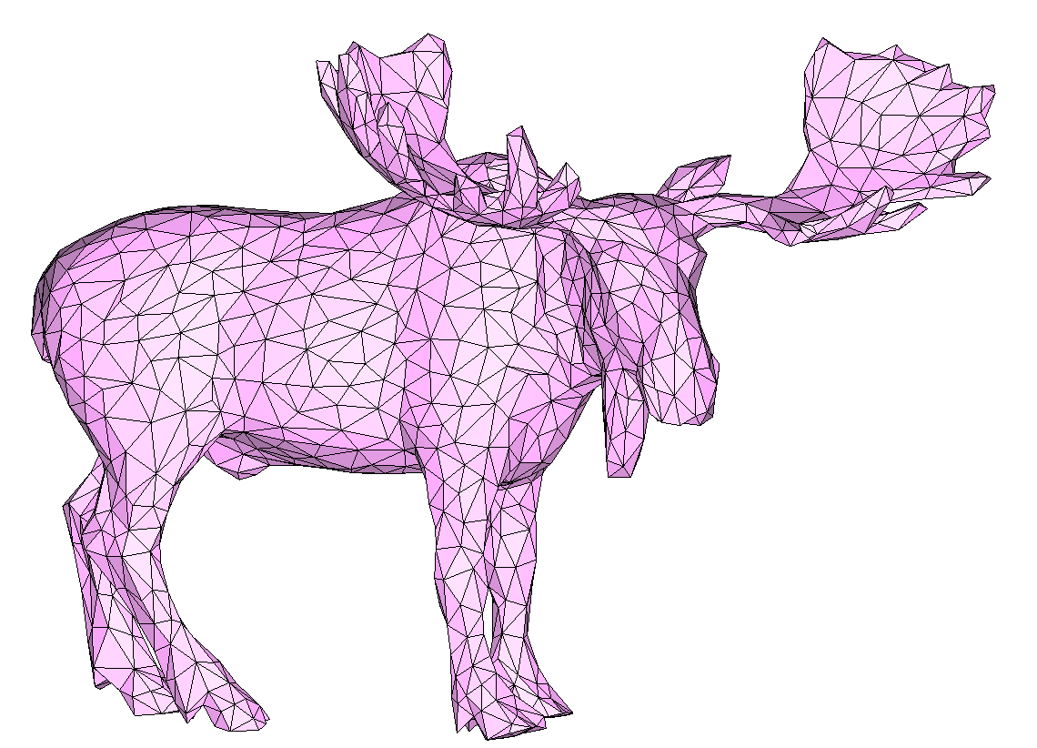
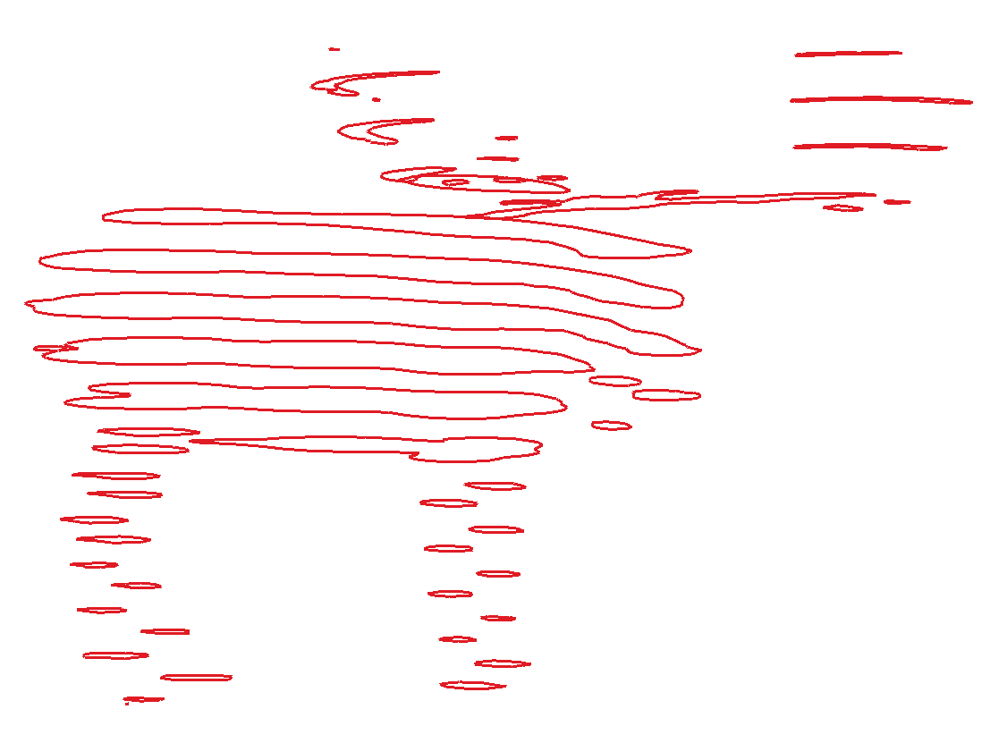
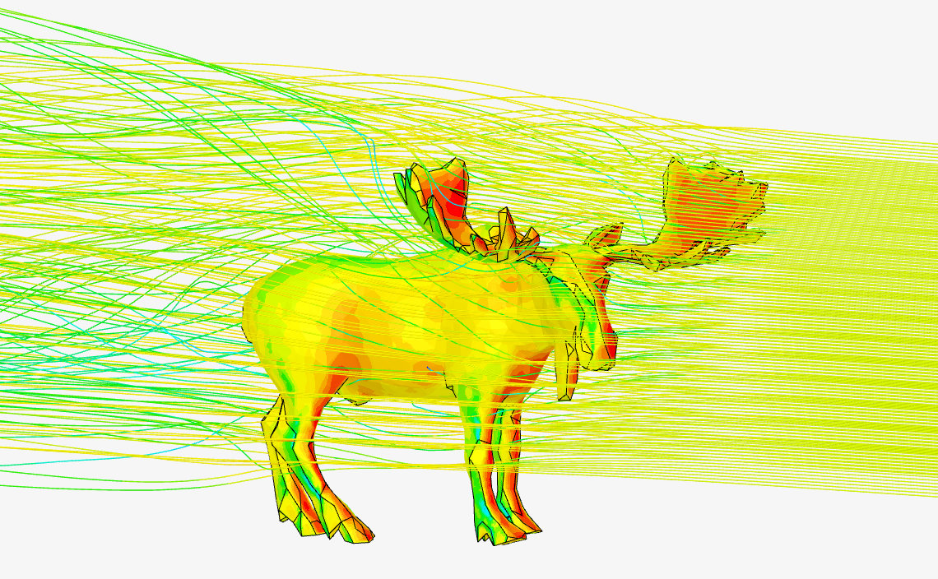
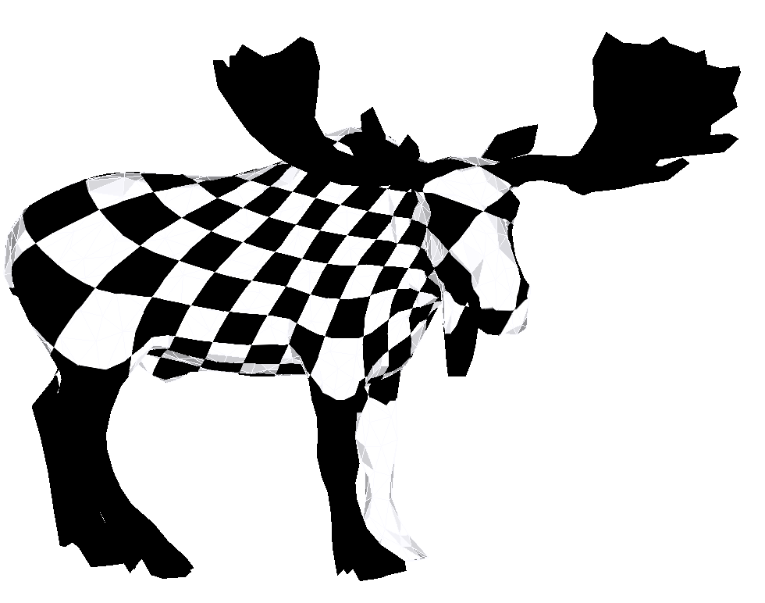
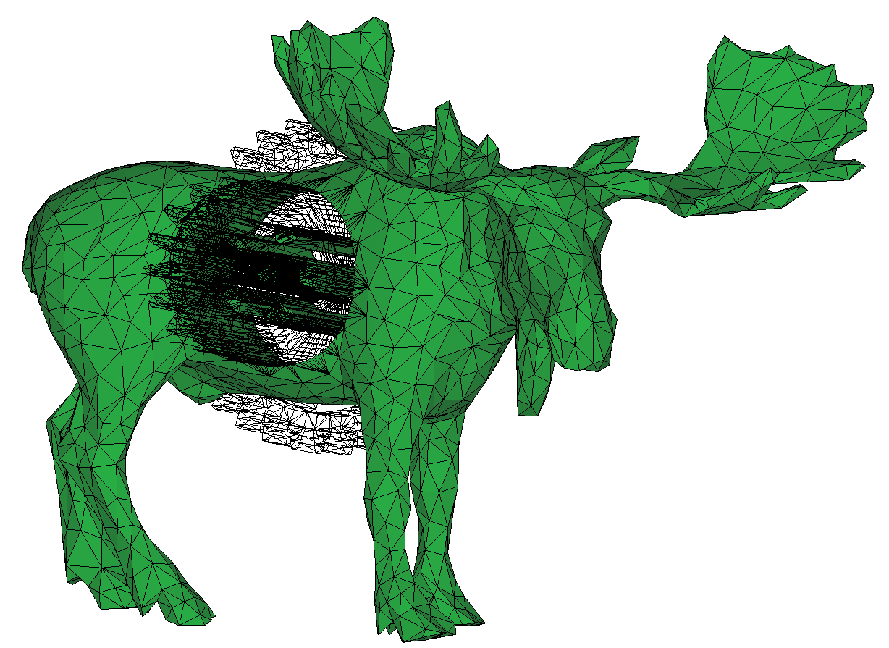
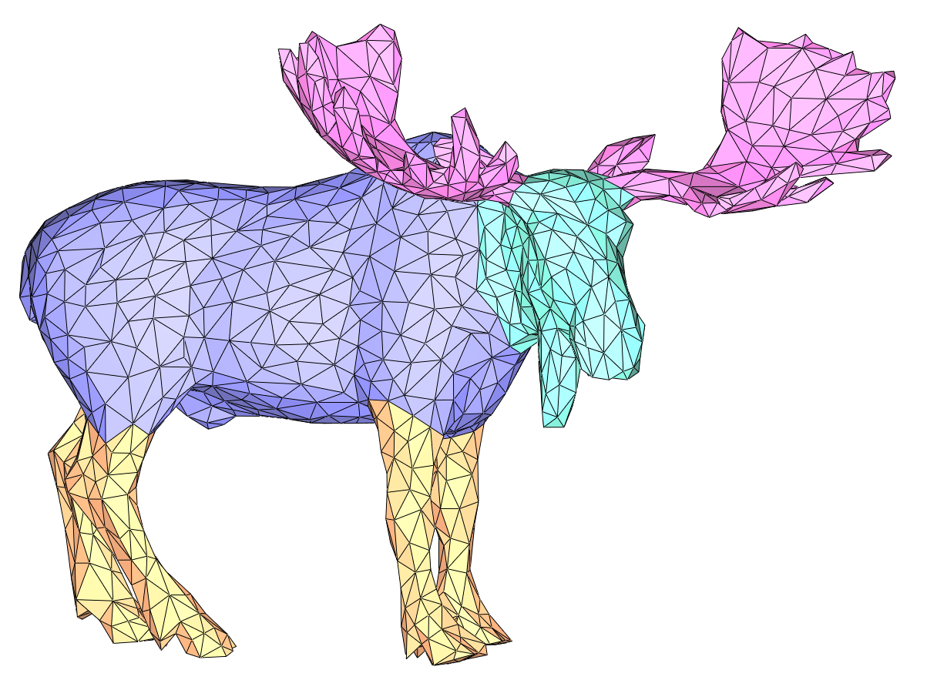
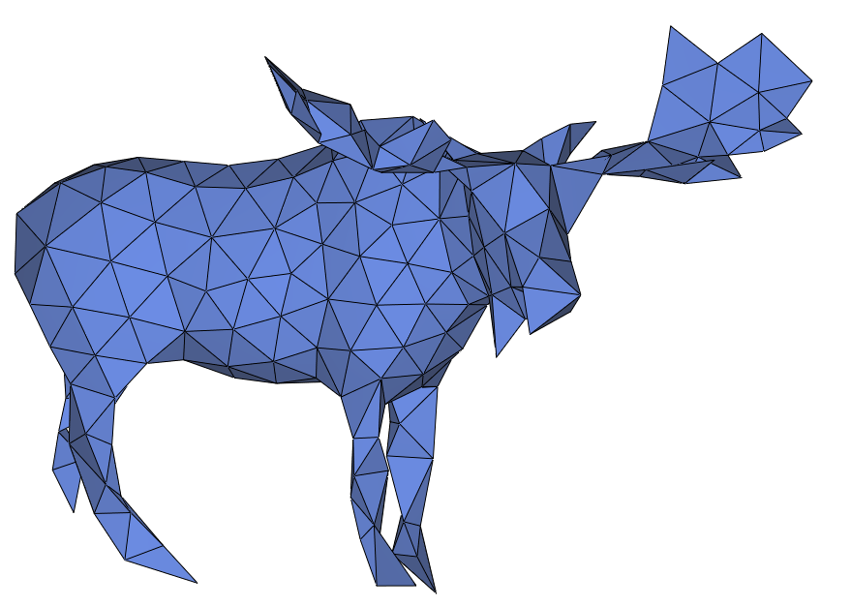
Motivation: Mesh validity
What is mesh validity?
A mesh is valid if it is:
2-manifold combinatorially and geometrically
Without self-intersections
Mesh validity is crucial to many applications in geometry processing and computer graphics
Computing distances
Slicing
Moose [Jérémie Louvetz]
Parameterization
Simulations
Parameterization
Segmentation
Boolean Operations
Remeshing & Simplification
Notes:
Voice: Surface meshes are essential components in many geometry processing and computer graphics application. Most applications require, or at least prefer, input meshes that are combinatorially 2-manifold, watertight, and orientable.

Slide 3
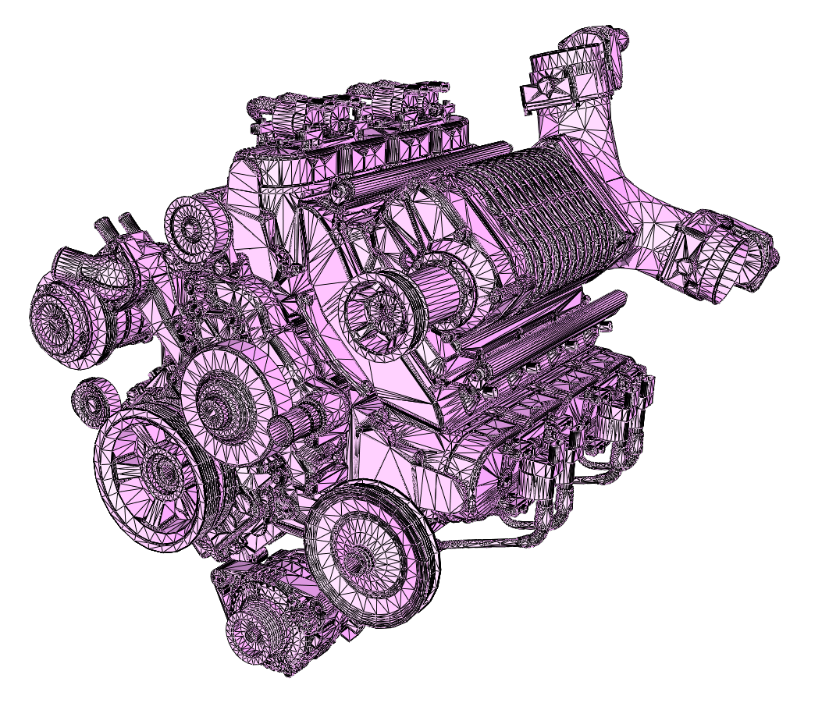
Motivation: mesh validity
Many meshes are not valid
Chevy Engine [GrabCAD]
Notes:
Voice: Unfortunately, many mesh generation methods are imperfect and oftentimes produce meshes such as this engine mesh with many issues

Slide 4
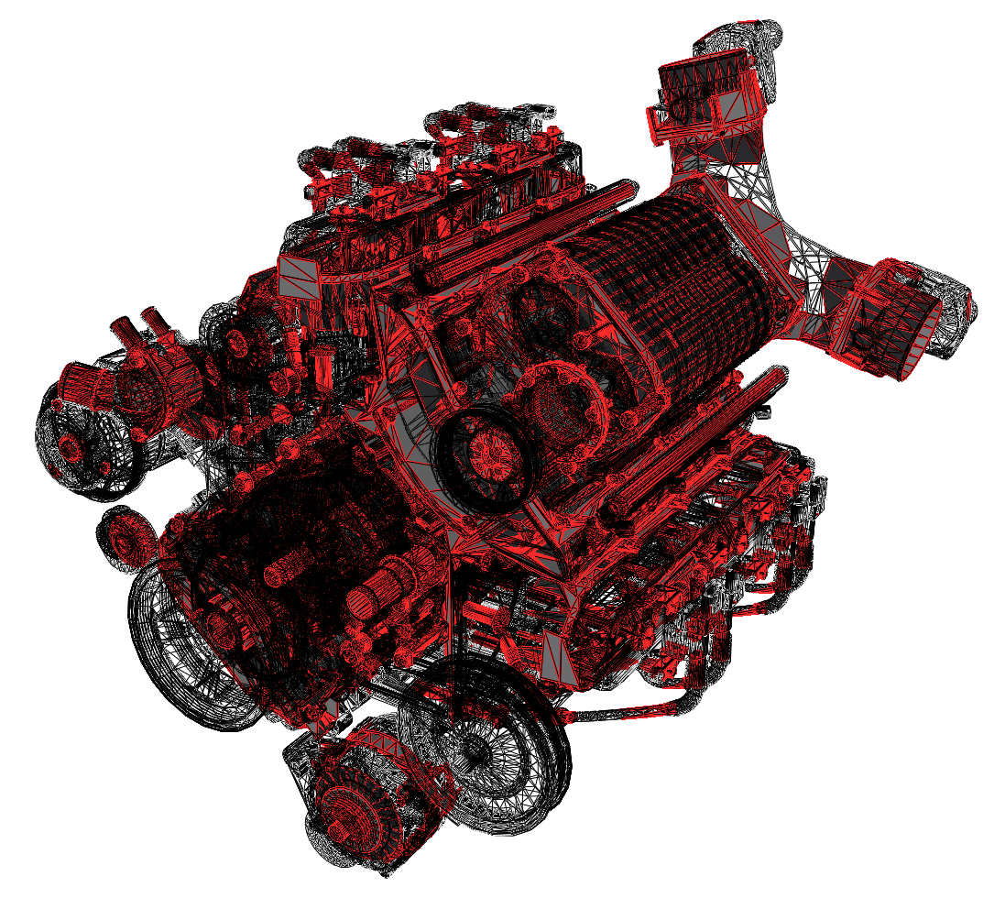
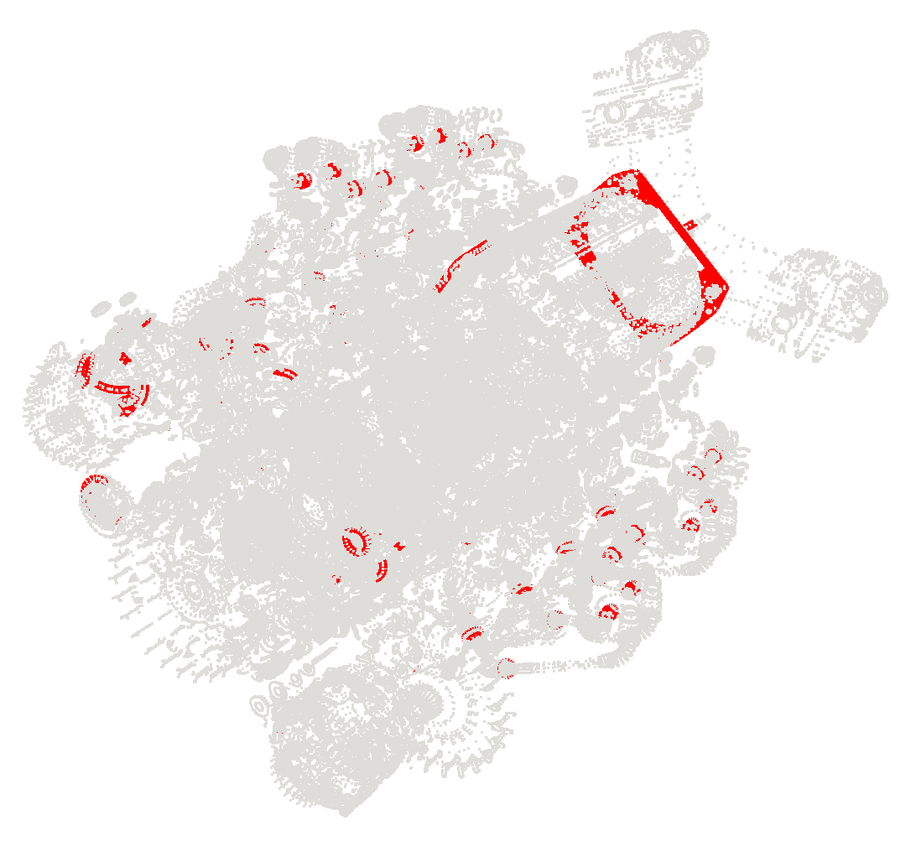
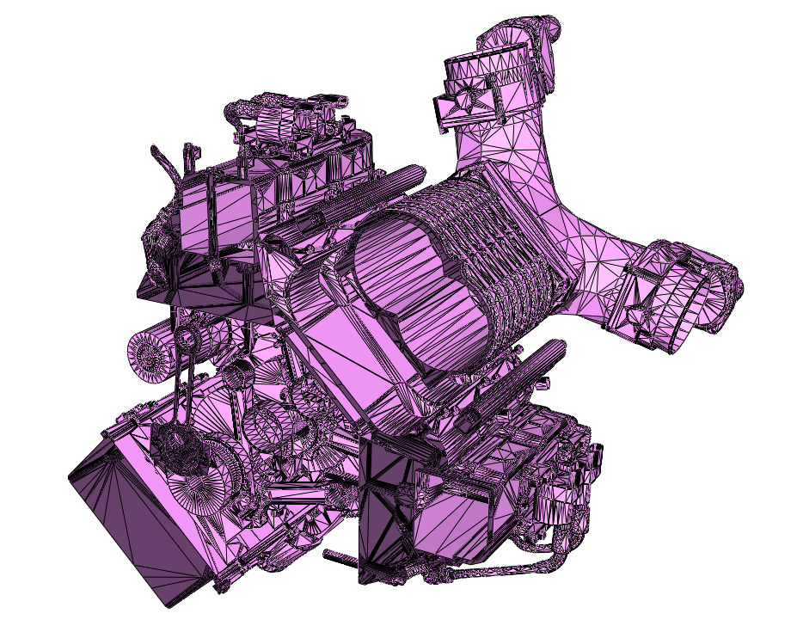
Motivation: mesh validity
Many meshes are not valid
Self-intersections
Non-manifoldness & spurious boundaries
Complex inner structures
Notes:
Voice (cont.): Unfortunately, many mesh generation methods are imperfect and oftentimes produce meshes such as this engine mesh with many issues

Slide 5
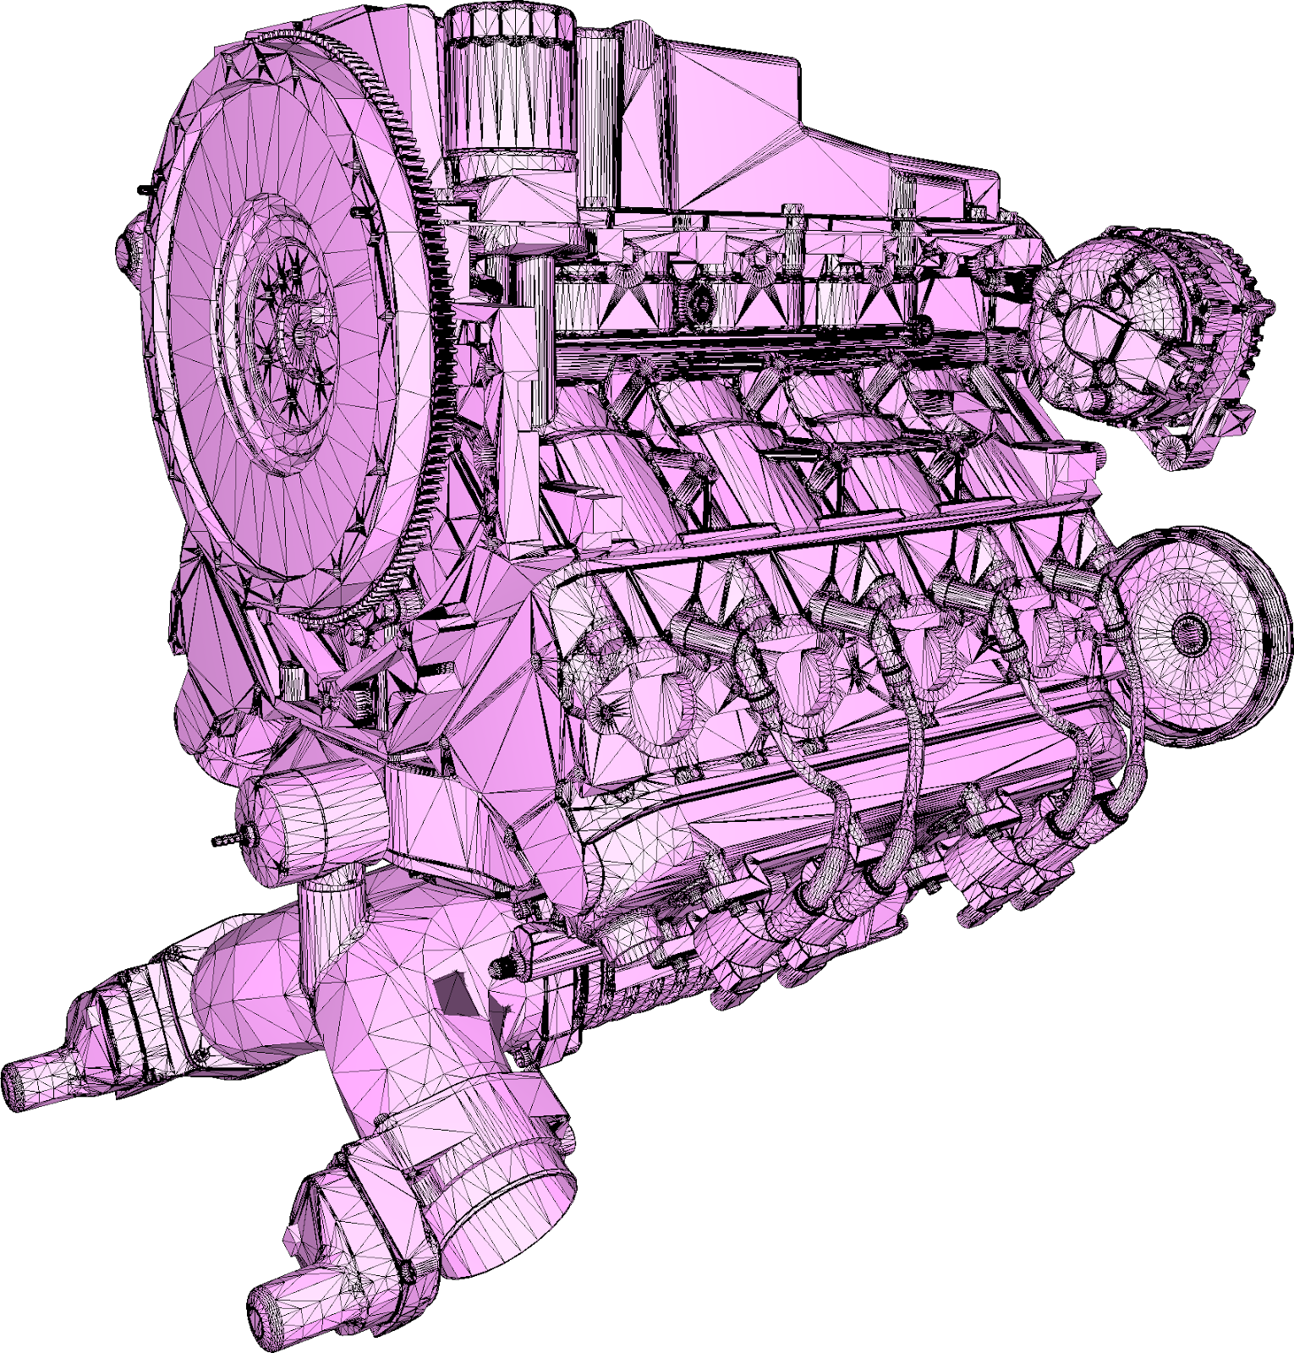
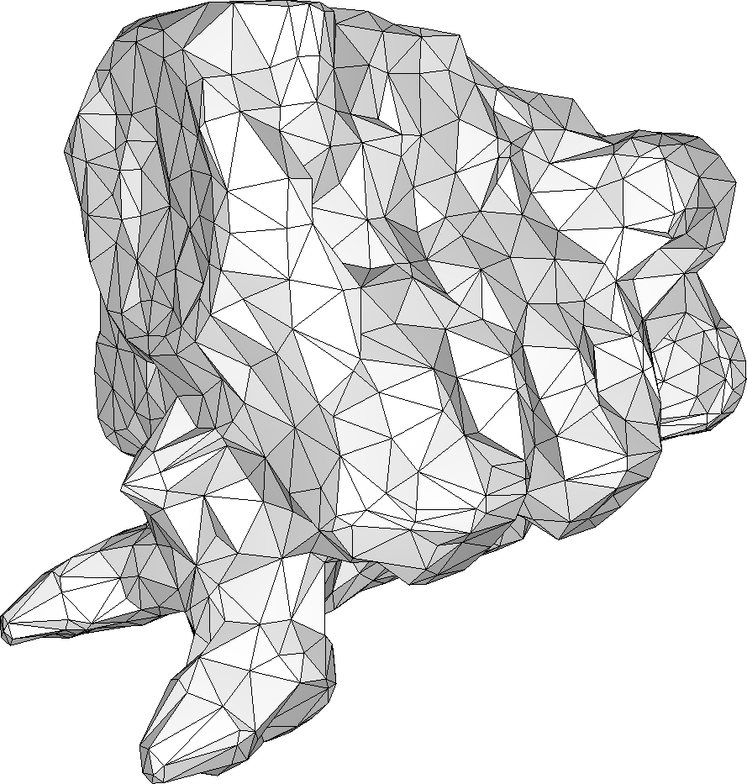
Problem statement
Input
3D model, possibly with defects
DESIRED Output
Watertight, manifold triangle mesh
No self-intersections
Enclosing the input
Unconditional robustness to input defects
Well-shaped (isotropic) triangles
Efficiency:
Ignore inner structures
asdas
Notes:
Voice: We address the problem of generating a watertight and orientable surface triangle mesh that strictly and tightly encloses the input. The algorithm must be robust to defects.

Slide 6
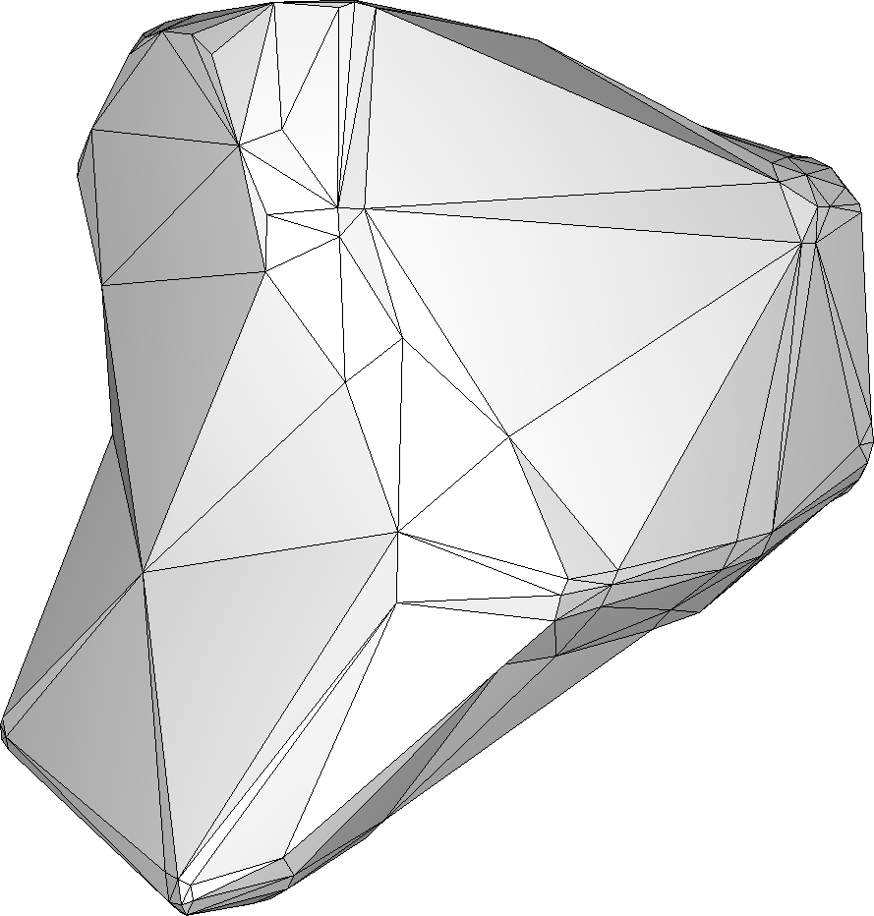
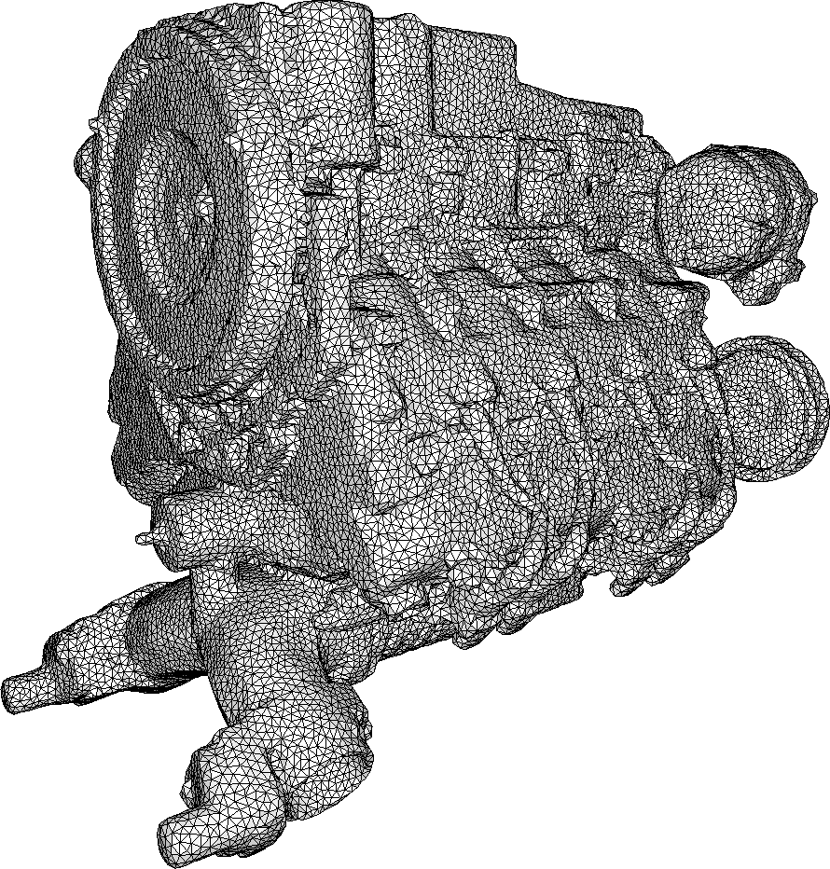
Problem statement
Input
3D model, possibly with defects
DESIRED Output
Watertight, manifold triangle mesh
No self-intersections
Enclosing the input
Unconditional robustness to input defects
Well-shaped (isotropic) triangles
Efficiency:
Ignore inner structures
Controllable complexity of output
Notes:
Voice (cont.): In particular, we wish to have a way to control the complexity of the output

Slide 7
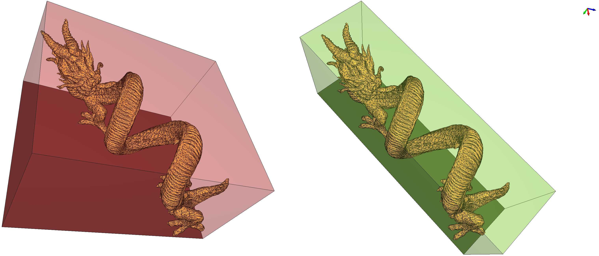
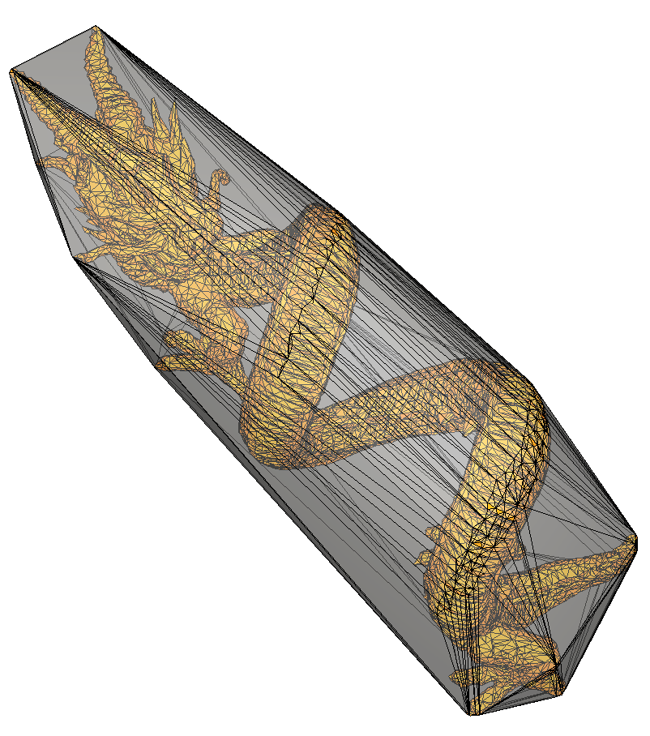
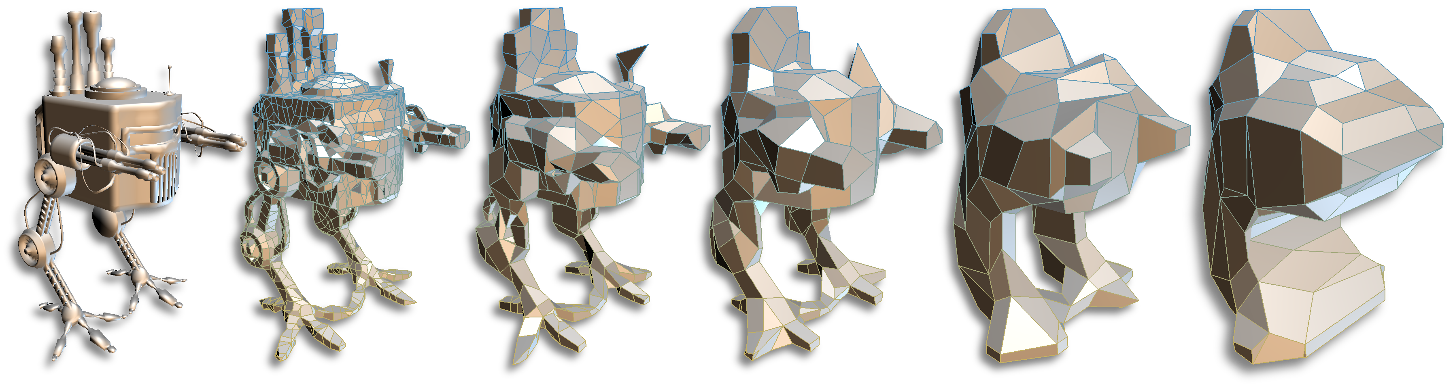
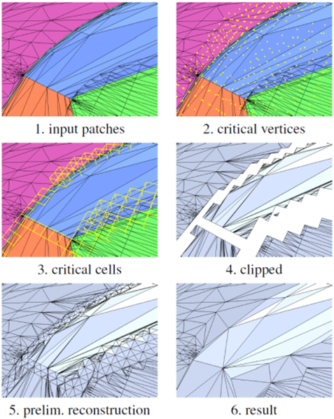
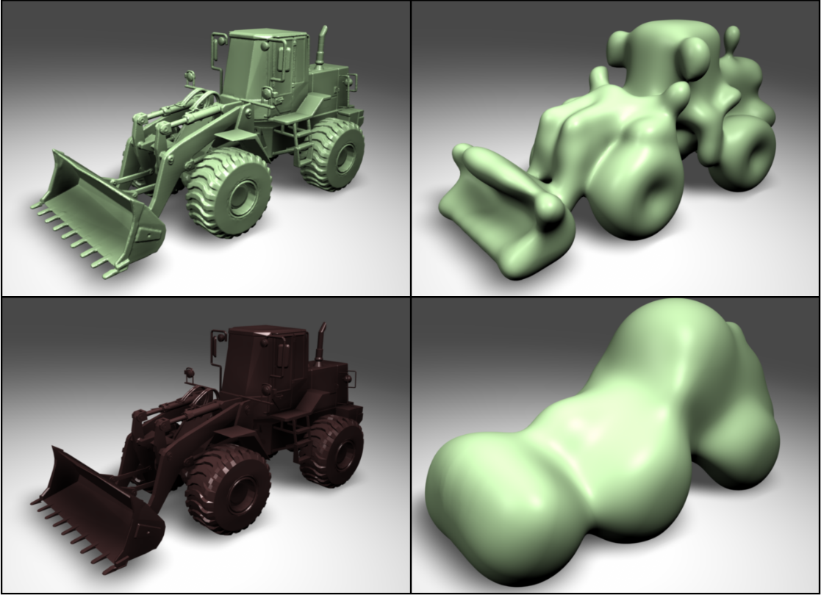
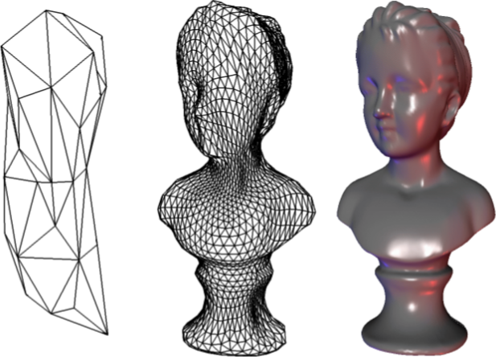
State of the art
Many solutions, but none satisfying our criteria
BOUNDING VOLUMES [TOUSSAINT 83, CHANG ET AL. 11]
ADVANCED BOUNDING VOLUMES [CALDERON & BOUBEKEUR 17; Wang et al. 20]
IMPLICIT SURFACE MESHING [SHEWCHUK 04]
SHRINK-WRAPPING [KOBBELT 99, LEE 10, JURETIĆ 11, MARTINEAU 2016]
MESH REPAIR [ATTENE ET AL. 13]
Notes:
Voice: This problem is not new and some trivial solutions such as the AABB, the OBB, or the Convex Hull, exist, but the tightness is weak.

Slide 8
Approach
Bridging the gap between
Alpha carving
and
shrink wrapping
Notes:
Voice: Our approach bridges the gap between a number of existing approaches by combining alpha shapes, mesh carving, and Delaunay-based meshing.

Slide 9
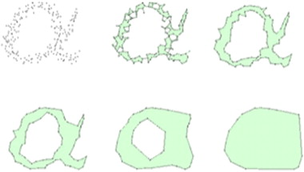
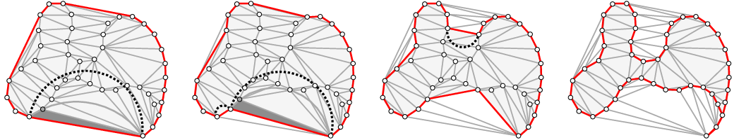
Alpha shapes & carving
Alpha shapes [Edelsbrunner-MÜCKE 94]
Requires sampling of whole input
Does not strictly enclose input
Delaunay carving [Boissonnat 84, Bernardini-Bajaj 97, Giesen 02, Edelsbrunner 03, Allegre 05]
Requires sampling of whole input
Allegre 05
Notes:
Voice: We quickly recall these notions: the alpha shape is a generalization of the notion of convex hull. A visual analogy of this structure is to think of the ambient space as ice cream and the input points as chocolate pieces. The result of carving the ice-cream with a spherical spoon of radius 𝛼 is an intuitive description of the so-called alpha shape.
Delaunay carving is a similar concept. However, these two classes have a number of strong downsides, mainly a sampling of the full domain is required, and the result is not necessarily manifold.

Slide 10
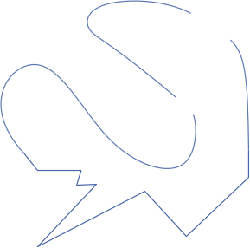
Alpha shapes & carving
Carve the space with a ball of radius alpha
Notes:
Voice: Here is an example of alpha shape computations in 2D, with different values of alpha to illustrate the process.

Slide 11
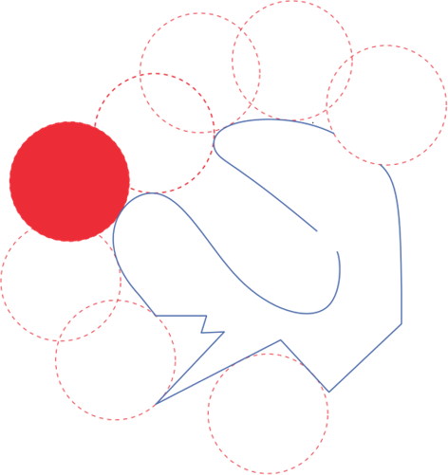
Alpha shapes & carving

Slide 12
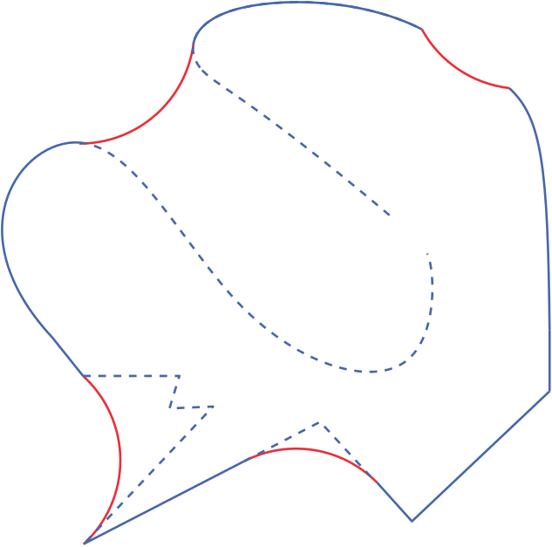
Alpha shapes & carving
Carve the space with a ball of radius alpha

Slide 13
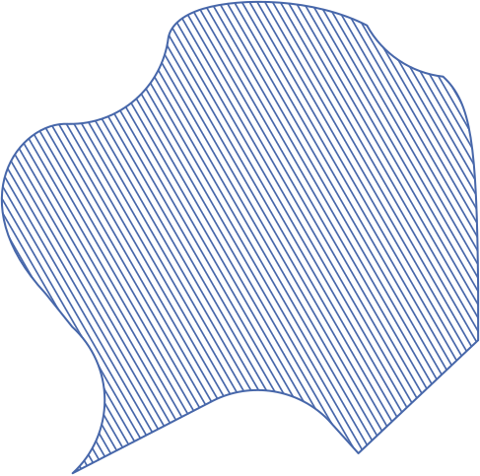
Alpha shapes & carving
Carve the space with a ball of radius alpha

Slide 14
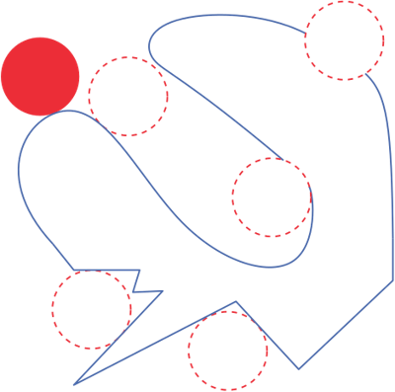
Alpha shapes & carving
Radius Alpha: Control over the tightness of the result
Notes:
Voice: A smaller alpha enables a better approximation as output

Slide 15
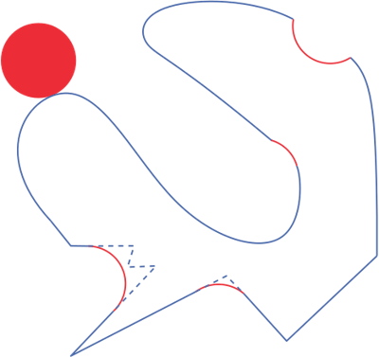
Alpha shapes & carving
RADIUS Alpha: Control over the tightness of the result

Slide 16
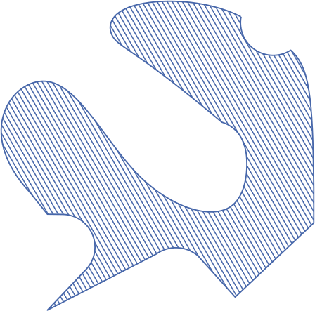
Alpha shapes & carving
RADIUS Alpha: Control over the tightness of the result

Slide 17
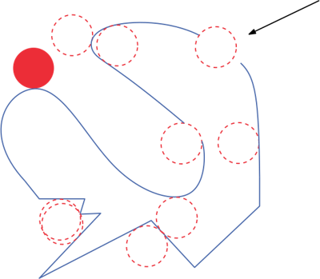
Alpha shapes & carving
Too-SmALL ALphA: Unsatisfactory result
Notes:
Voice: But if alpha is too small, the carving ball can enter holes and the result is not a closed manifold mesh.

Slide 18
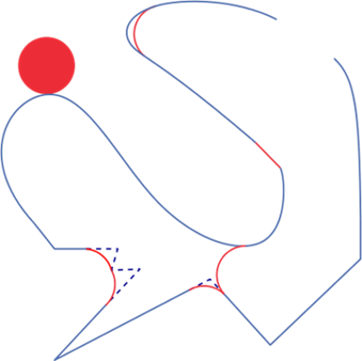
Alpha shapes & carving
Too-SmALL ALphA: Unsatisfactory result

Slide 19
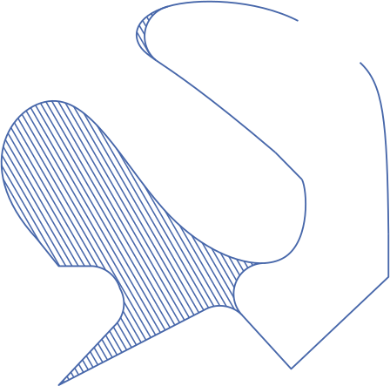
Alpha shapes & carving
Too-SmALL ALphA: Unsatisfactory result

Slide 20
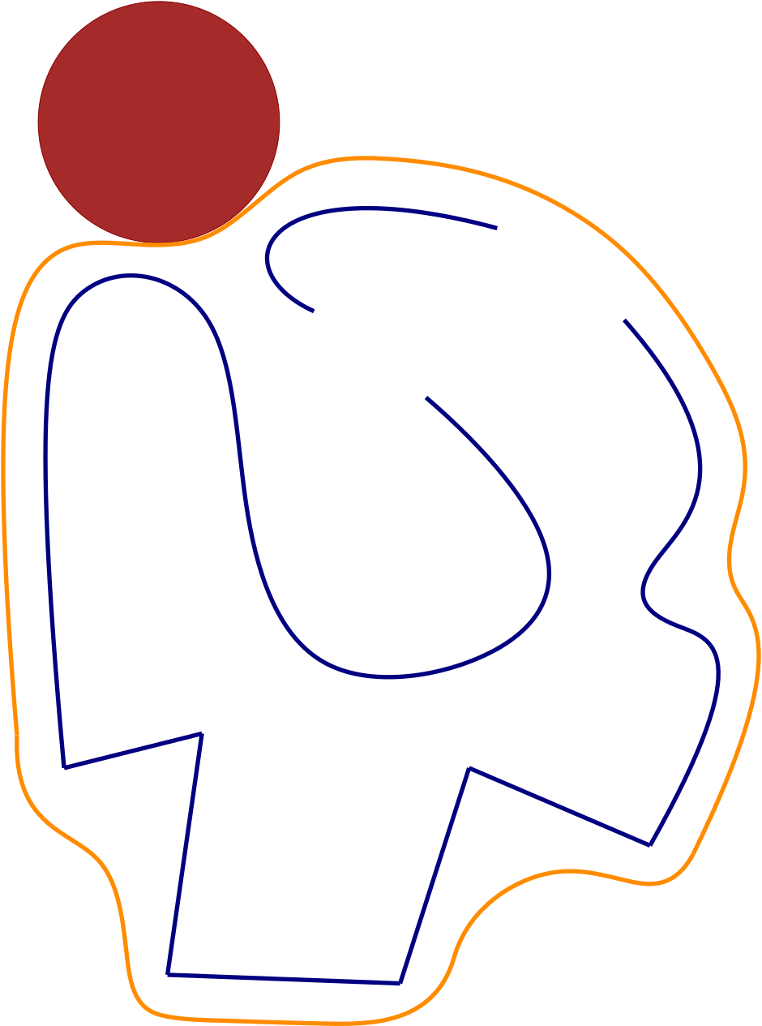
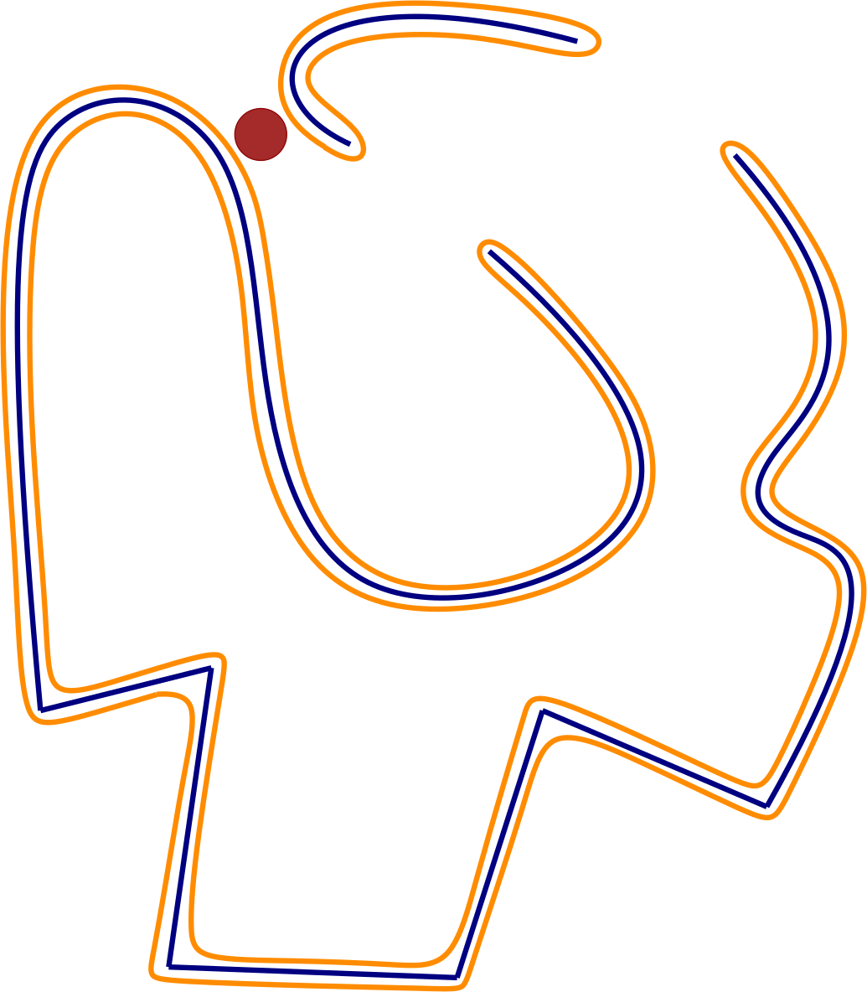
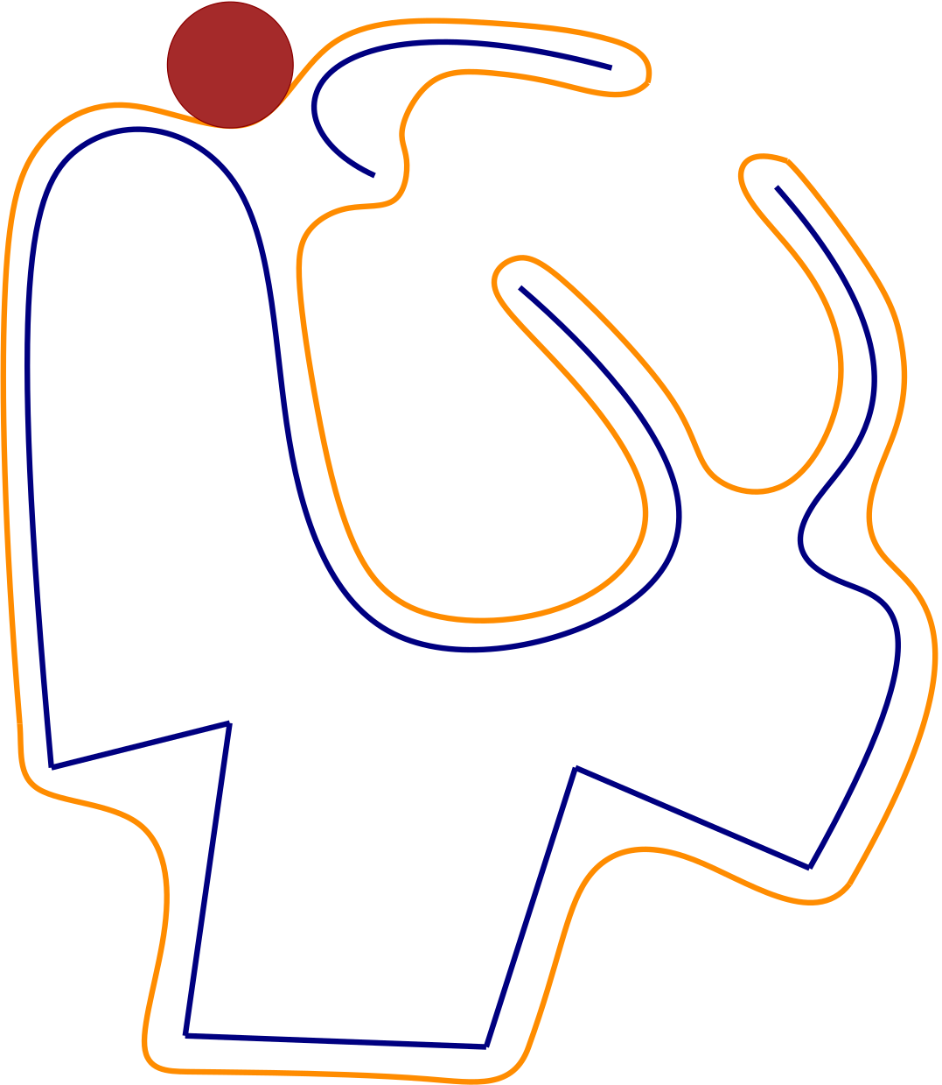
Alpha shapes & carving
Making it work for all alphas: using an Offset iso-surface
Notes:
Voice: Our solution is to perform alpha carving not of the input, but at the offset surface, which is the set of points at given and fixed distance from the input. This guarantees that the result is a closed manifold shape, whichever the values of alpha and the distance from the input. However, we must now generate points on this offset surface.

Slide 21
Meshing
Algorithm overview
Wrap from outside, starting from a bounding box
Alternate carving and Delaunay refinement operations
Maintain a valid boundary at all times
Underlying structure: 3D Delaunay triangulation
Well-known, safe choice (in theory and in practice)
Ties seamlessly with the concept of alpha shapes
Notes:
Voice: To create these points on the offset surface, we use an ambient 3D Delaunay triangulation and alternate carving and Delaunay refinement.

Slide 22
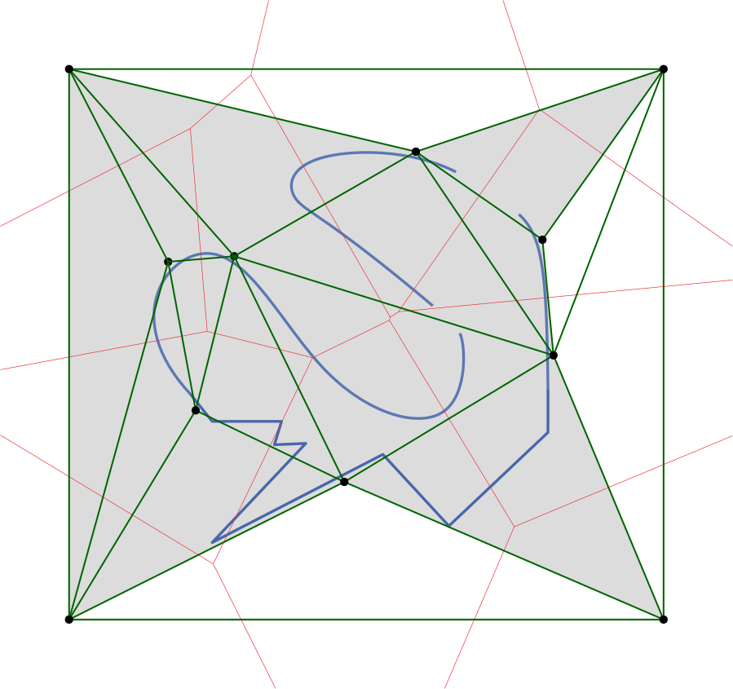
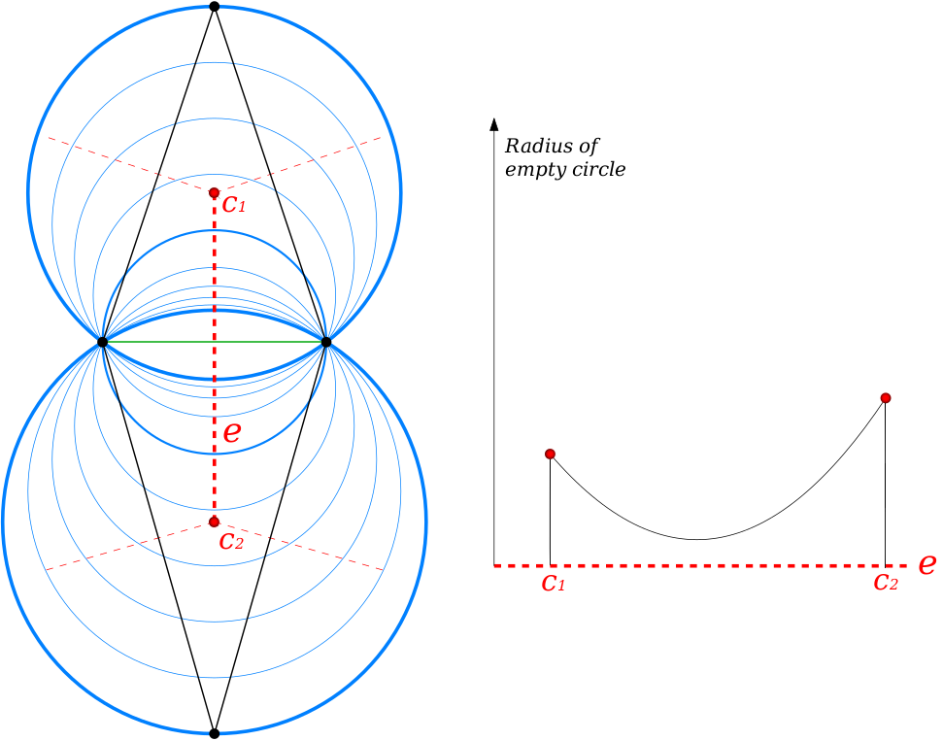
carving
Algorithm overview
Boundary: Tetrahedral cells flagged inside or outside
Traversal: If a facet has a circumradius greater than a user-defined alpha, it is traversable
Notes:
Voice: Starting from a loose bounding box of the input, we flag tetrahedral cells "inside" and "outside". The output surface is defined as the boundary between these two types of cells. A carving, or "traversal", operation is performed if an inside cell does not intersect the input.

Slide 23
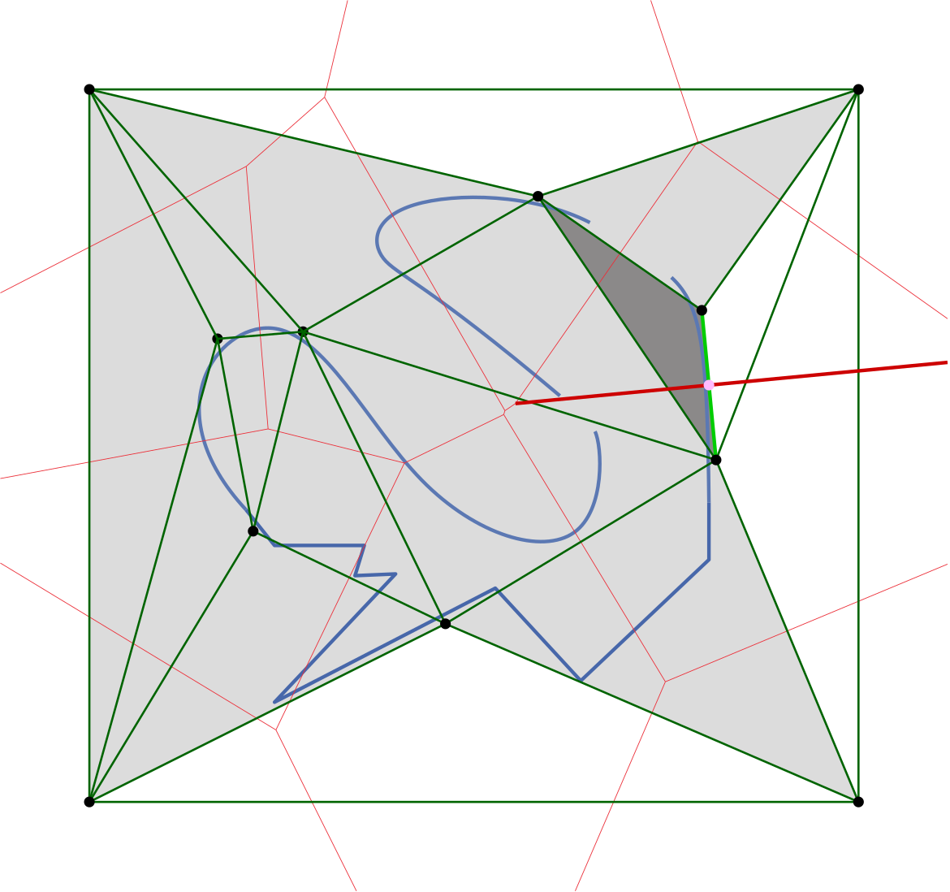
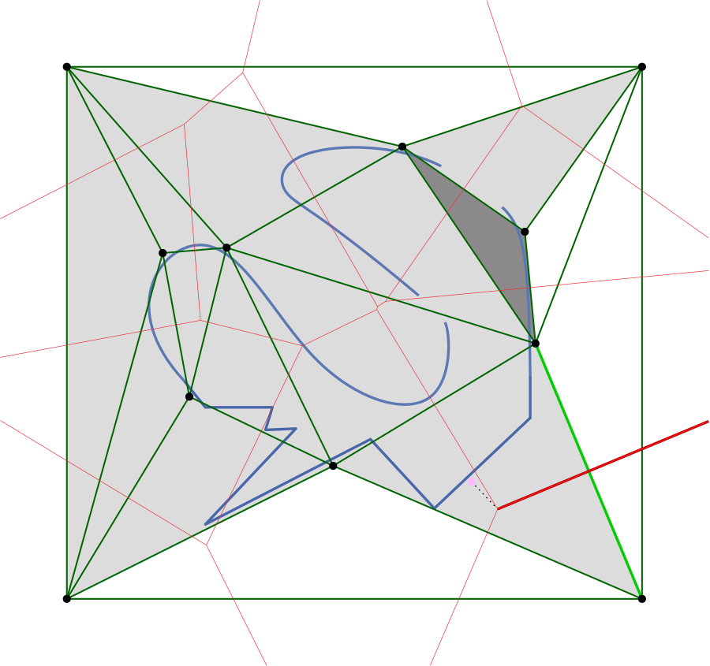
Refinement
Rule #1: given a traversable facet f, if its dual edge intersects the offset surface, insert intersection point (common Delaunay refinement).
Rule #2: if Rule #1 does not apply and the inside tetrahedron incident to the traversable facet f intersects the input, then insert the point on the offset surface closest to the circumcenter of the inside cell.
Notes:
Voice: Two refinement rules apply when carving is impossible, to densify the mesh and tighten the approximation. The first rule is a classic Delaunay refinement insertion, inserting the intersection of the dual edge with the offset surface. We add a second rule, whose purpose is to refine "inside" cells that are incident to traversable faces but for which the dual edge does not intersect the offset surface.

Slide 24
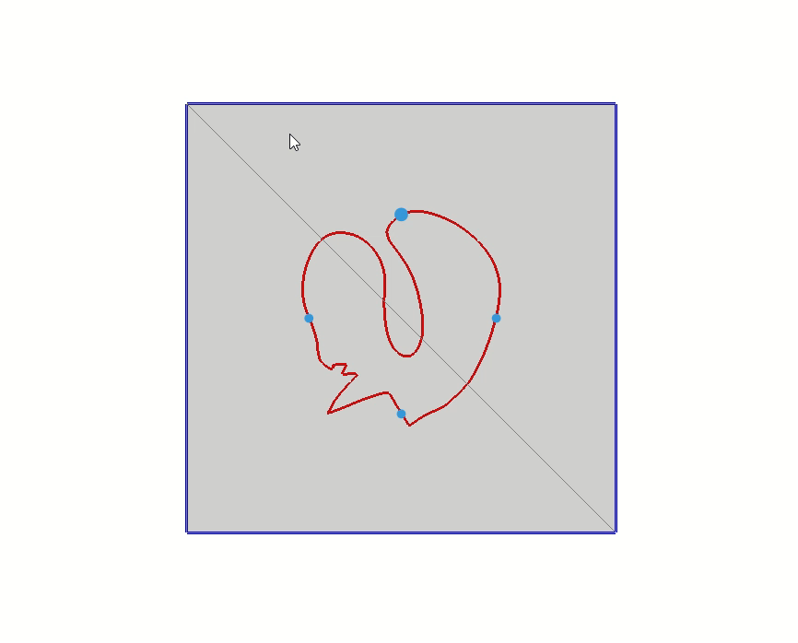
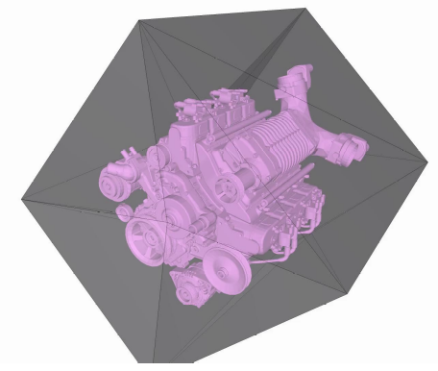
Algorithm illustration in 2D and 3D
Notes:
Voice: Here is an illustration of the algorithm on a simple 2D model

Slide 25
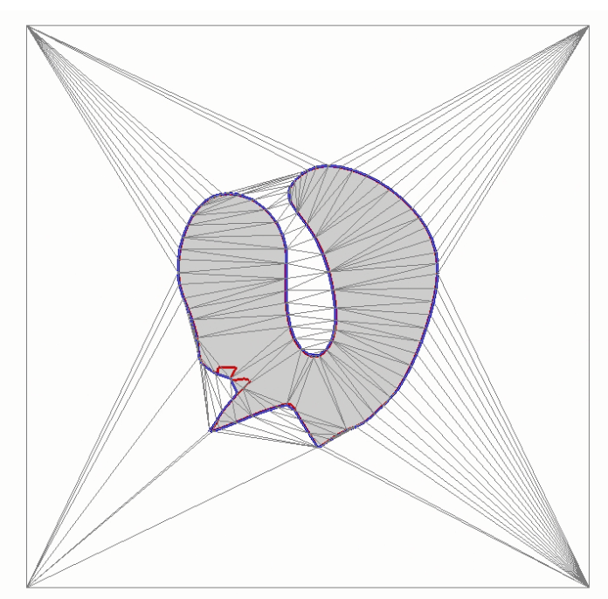
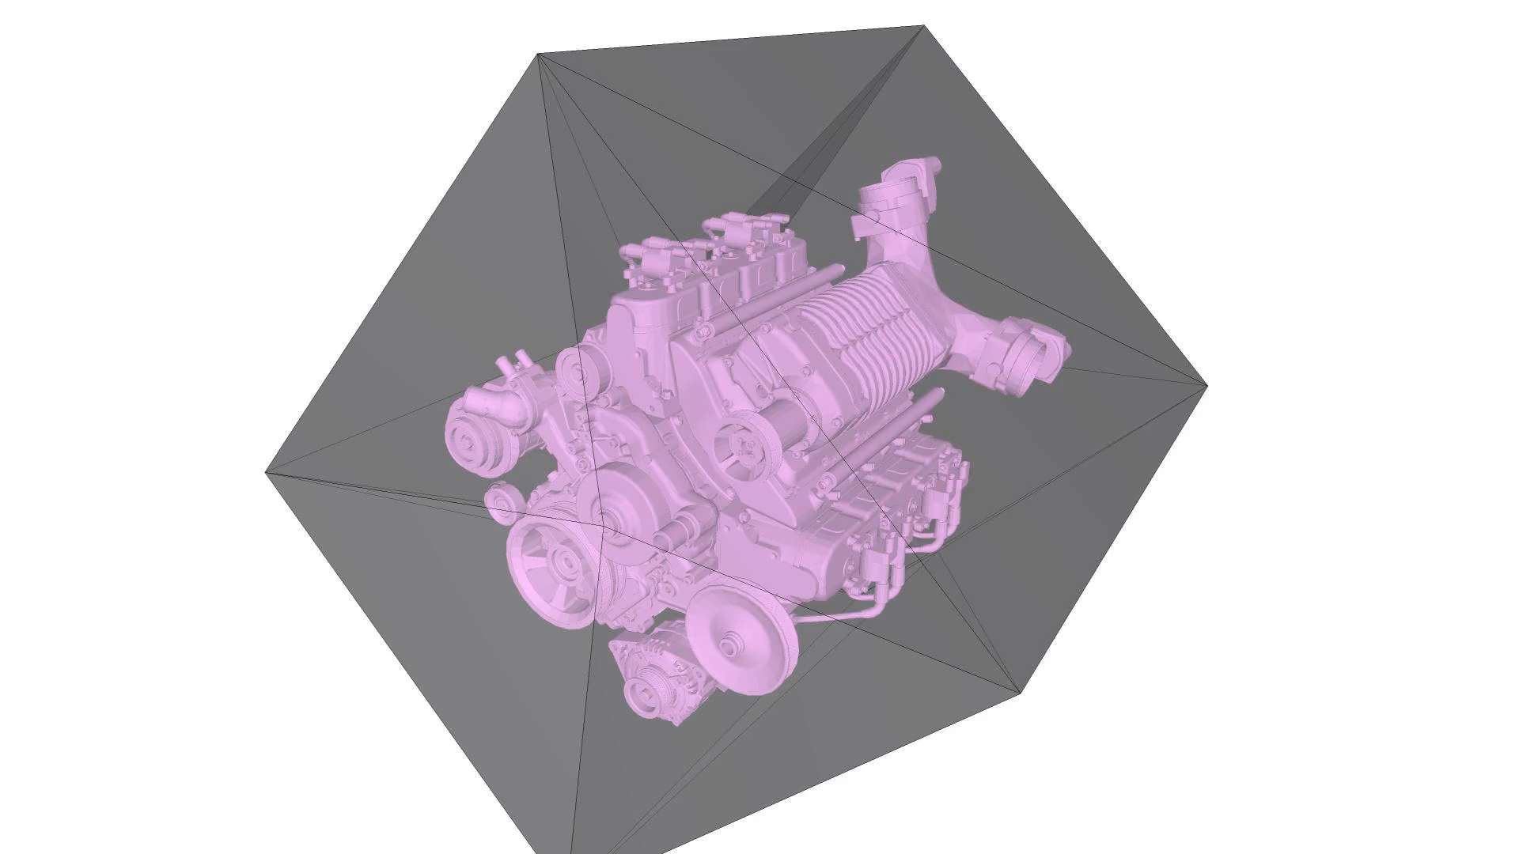
Algorithm illustration in 2D and 3D
Notes:
Voice: Here is an illustration of the algorithm on a simple 2D model

Slide 26
Results
Notes:
Voice: We now present some applications to illustrate the usefulness of our method.

Slide 27
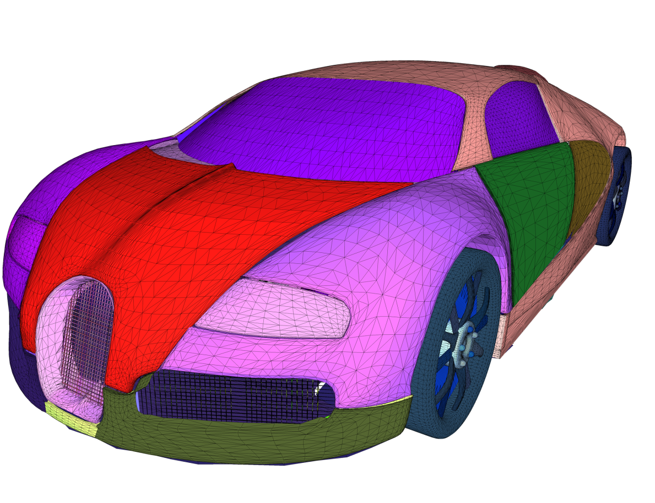
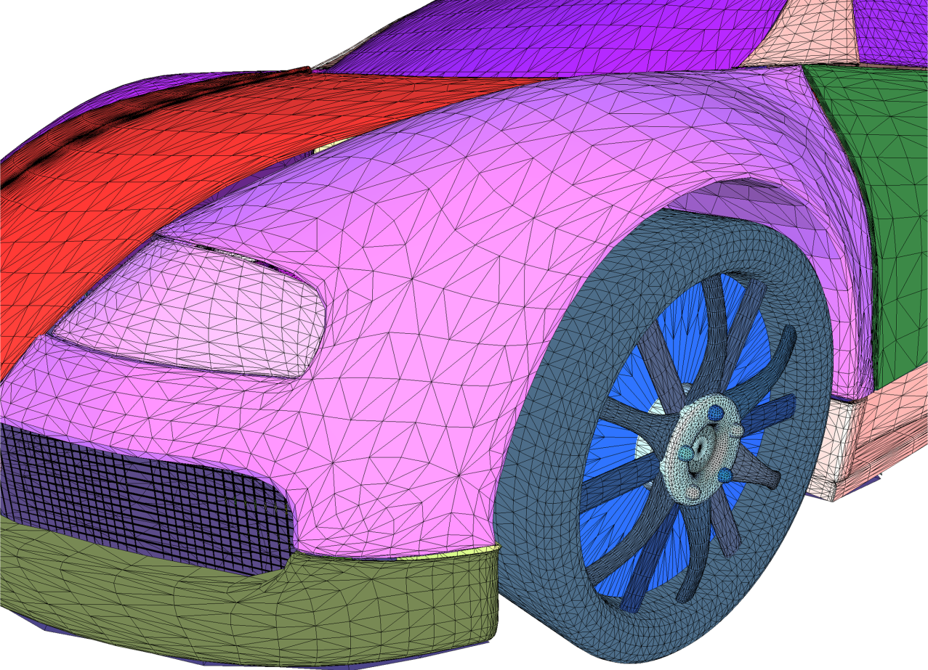
Application to FLOW SIMULATION
Bugatti model [Simscale], a defect-laden input
Multiple open connected components
Inner geometry
Degenerated elements
...
small holes
panel gaps & overlaps
Notes:
Voice: The following car model is riddled with all kinds of defect, making a flow simulation impossible. It also contains important inner geometry, which is irrelevant to the simulation.

Slide 28
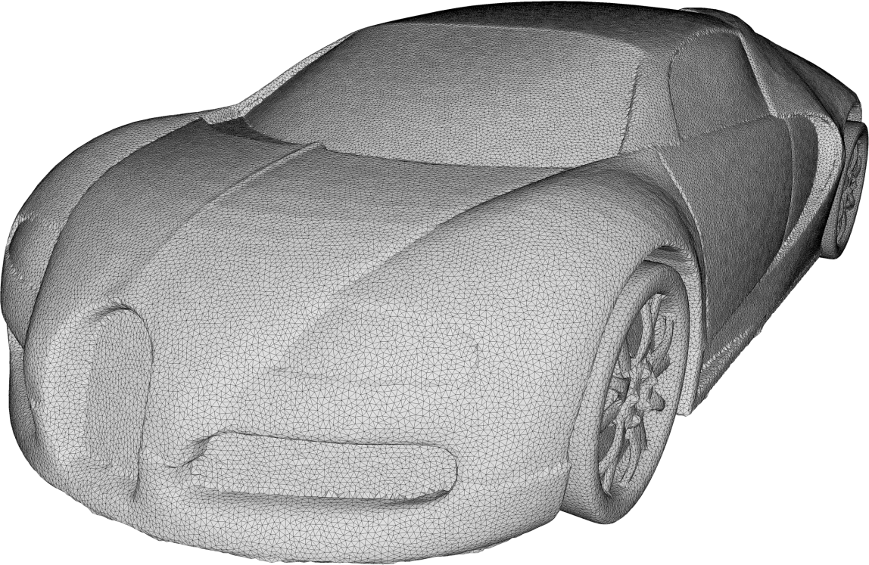
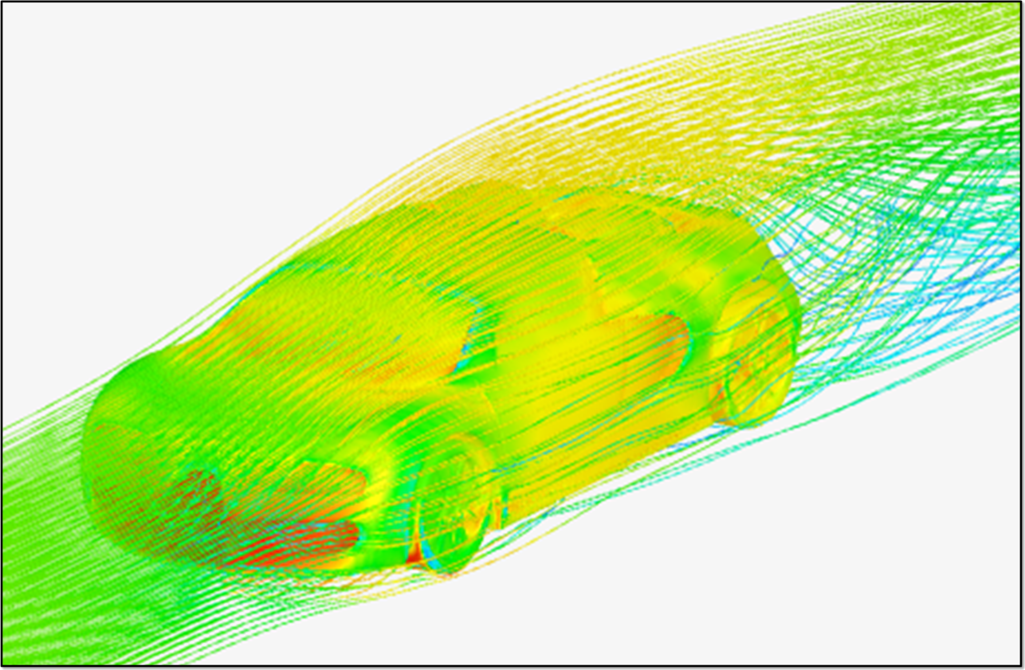
Application to flow simulation
Alpha Wrapping as input preprocessing for flow simulation
[Simscale]​
476k facets, 100s
Notes:
Voice: Our method produces a closed, manifold mesh on which simulations can be run successfully.

Slide 29
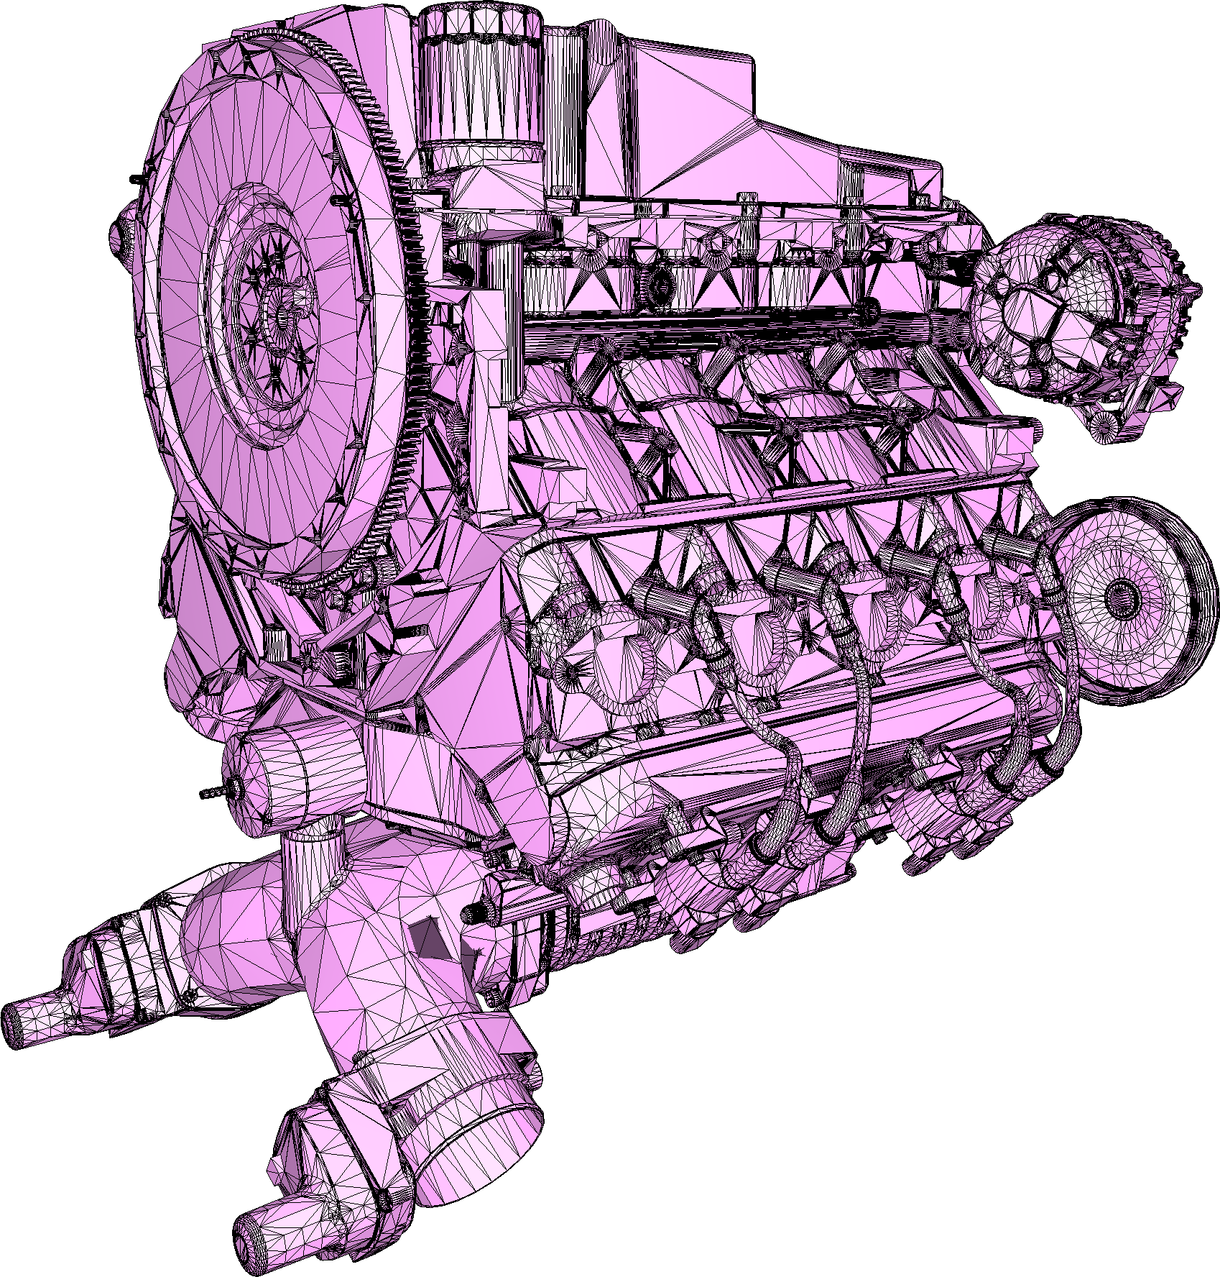


APplication to swepT volumes
Input:
Very large mesh
Complex inner structures
All kinds of defects
914s
1.7M facets
Output:
Lower mesh complexity
Valid mesh with no internal elements
Faster sweeping
Conservative and tight w.r.t. to exact sweep
242s
57k facets
Swept volumes by [RMAGS GmbH]
Notes:
Voice: Our method can also be used as a preprocessing step before sweeping, drastically reducing runtime.

Slide 30
Analysis

Slide 31




The alpha parameter
Main purpose: control the diameter of cavities to be explored
Can be arbitrarily small
Controls the output complexity
Alpha = BBox diagonal / 20
/ 50
/ 150
Lower complexity
Higher complexity
Notes:
Voice: The primary purpose of 𝛼 is to control the size of the empty balls used during carving: carving is only allowed through straits or holes with opening larger than 𝛼, and the value of the parameter determines which features will be present in the output.

Slide 32


The offset parameter
Main purpose: guarantee closed 2-manifold mesh
Can be arbitrarily small
Can also act as a defeaturing parameter, at the cost of tightness (similar to [Shewchuk 04])
Notes:
Voice: The second parameter, the offset distance, sets the distance between the input and the offset surface onto which the vertices of the output mesh are located, and thus controls the tightness of the output.

Slide 33

Combined influence
Alpha
Controls the diameter of cavities to be explored
Acts as sizing field
Offset
Can also act as a defeaturing parameter, at the cost of tightness (similar to [Shewchuk 04])
offset
alpha
input
Notes:
Voice: The behavior of the offset is similar to that of 𝛼 when it comes to features: small offset values ensure that the mesh is close to the input, and thus that it will capture well its geometry and features; on the other hand, large offset values act as a defeaturing tool.

Slide 34
Strengths
Notes:
Voice: We now expose the strengths of our method.

Slide 35



OUTPUT Sensitive COMPLEXITY
Notes:
Voice: The complexity of our algorithm depends primarily on the complexity of the output, meaning that complex inner structures have only a weak influence on the runtime, and no internal sampling is required.

Slide 36

Robustness
Distance field-based approach: unconditional robustness to defects
Notes:
Voice: Thanks to its formulation making only use of an implicit distance function and basic intersection predicates, our algorithm is immune to the usual defects found in many meshes.

Slide 37

Correctness
Correctness: theoretical guarantees
Experimental Validation
Termination: using a 3D Delaunay triangulation enables use of the usual arguments (separation distance & packing argument)
No self-intersections, manifold: final surface mesh is extracted from a consistent underlying 3D triangulation
Closed, and enclosing the input: carving is disallowed if encroaching the input
Bounded one-sided Hausdorff distance (alpha + offset): faces of the output have a bounded Delaunay ball radius
Implementation: Code uses CGAL’s efficient exact predicates to ensure that theoretical guarantees are met.
Extensive assertions and tests: all checks are performed with exact computations, and the code is tested on large public datasets (Thingi10k, grabCAD, …)
https://www.cgal.org/
Notes:
Voice: Basing our algorithm on extensively studied data structures such as the Delaunay triangulation enabled us to guarantee in theory a number of important properties: termination, validity, input enclosing, and distance bounds.

Slide 38


Genericity
AGnostic to input representation: need only distances and simple intersections
triangles
points
segments
Notes:
Voice: Our implementation follows the CGAL genericity principle: one can easily switch the input representation (triangles, segments, points, …) and even combine them.

Slide 39


















Genericity
THANK YOU
@ SIGGRAPH LAB DEMO
Notes:
Voice: Thank you; code already available in CGAL. Join us at the SIGGRAPH Lab Demo in August for an extensive collaborative demo.

